Slide 1
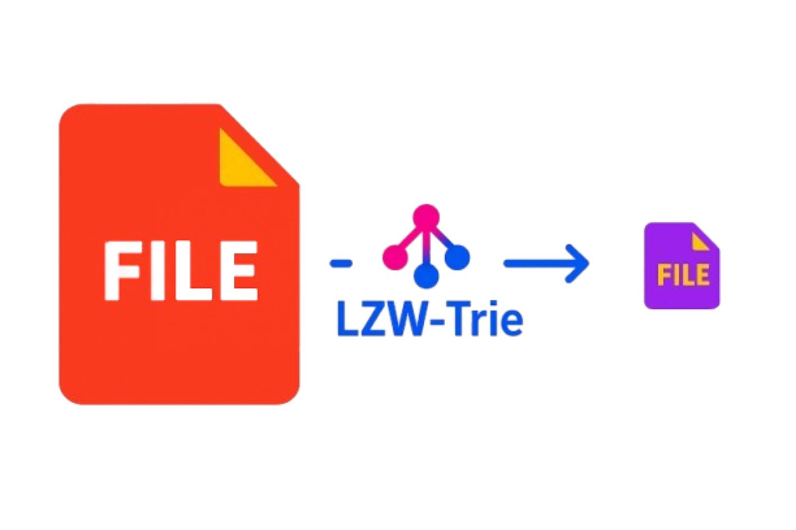
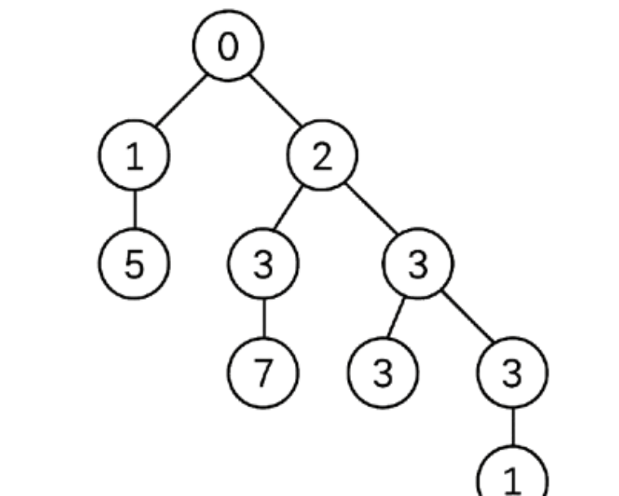

LZW-Trie: High-Speed Data Compression Using Trie Dictionary
A C++/Python Implementation for Efficient Lossless Compression
Team Leader : Sumit Kumar
Team Member : Aviral Maheshwari,
Anubhav Vashistha
Guided by : Dr. Jyoti Agarwal
DAA-IV-T251

Slide 2
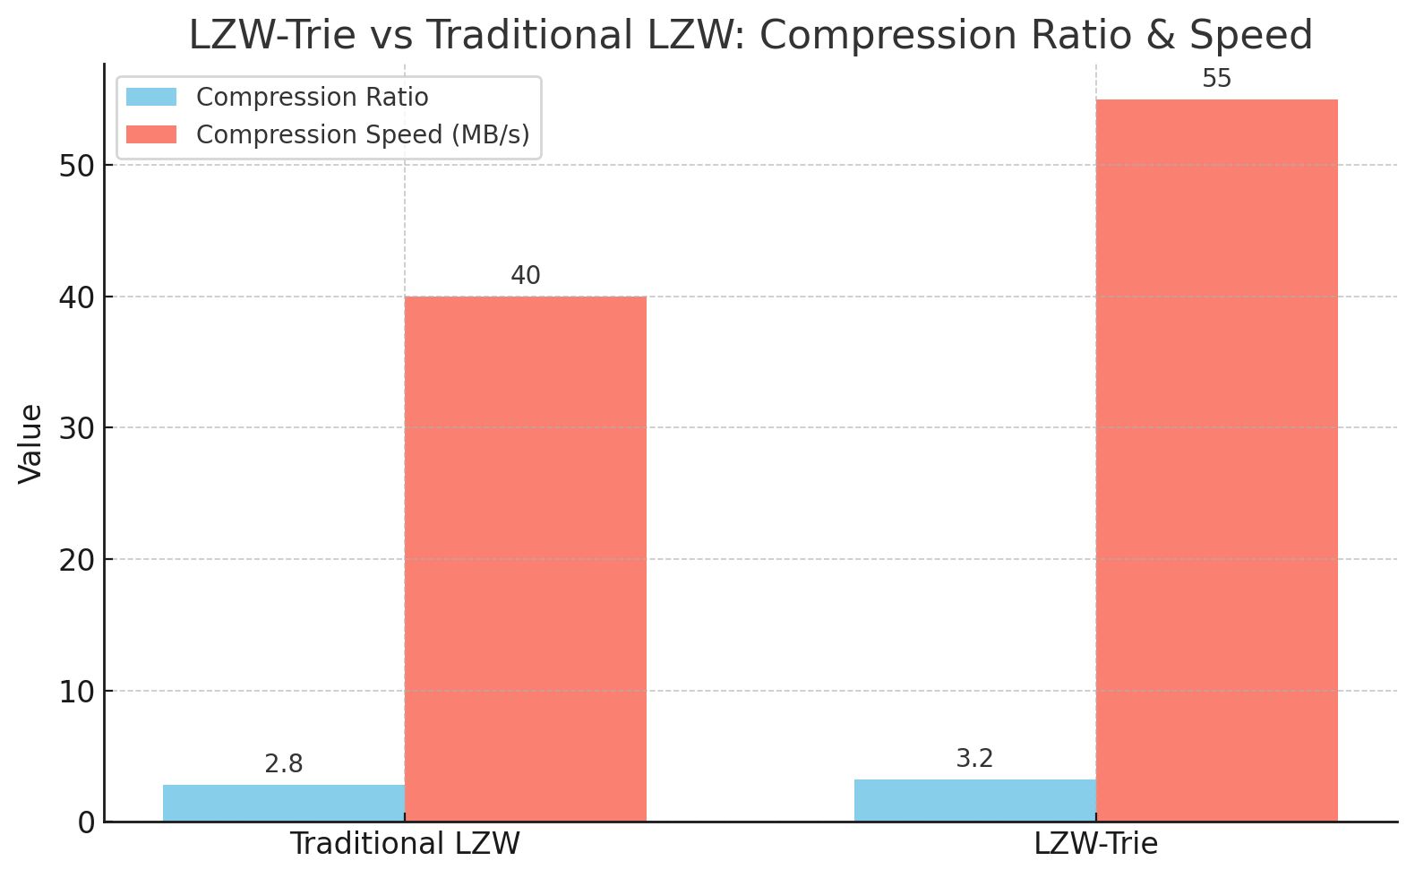
What We Aim to Achieve
Efficiency:
Reduce text file sizes by 40–60% using adaptive trie compression.
Speed:
Achieve 20% faster compression than standard hash-table LZW.
Scalability:
Handle files from 1KB to 1GB+ with dynamic memory management.
Education:
Demonstrate real-world trie applications in data compression.

Slide 3
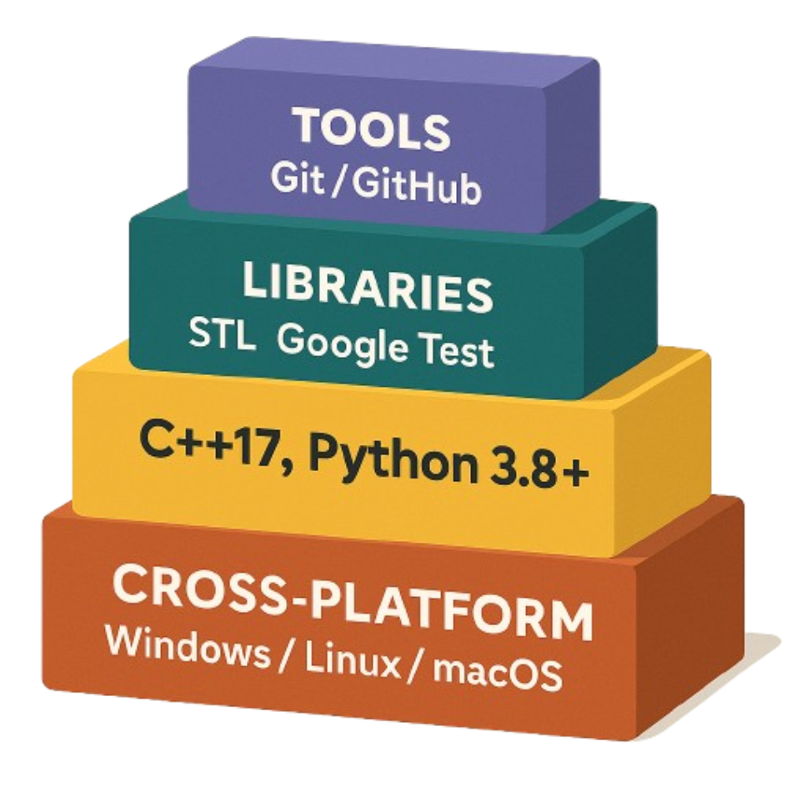
Built with Modern Tools
Languages: C++17 (Core), Python 3.8+ (Reference)
Libraries: STL (<unordered_map>, <memory>), Google Test
Tools: Git/GitHub
OS: Cross-platform (Windows/Linux/macOS)
Hybrid Trie-Hash Dictionary: Optimizes both speed and memory.

Slide 4
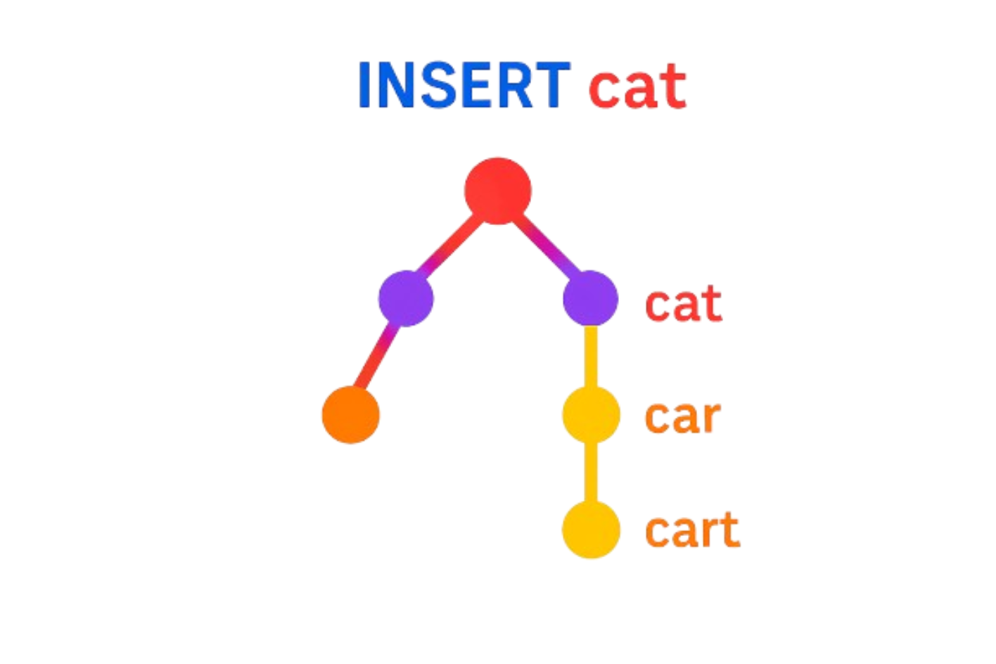
Why LZW + Trie?
Problem: Traditional LZW with hash tables is slow for prefix searches.
Solution: Trie cuts search time from O(n) → O(k) (k = key length).
Use Case: Ideal for compressing:
Log files
Source code
Repetitive datasets

Slide 5
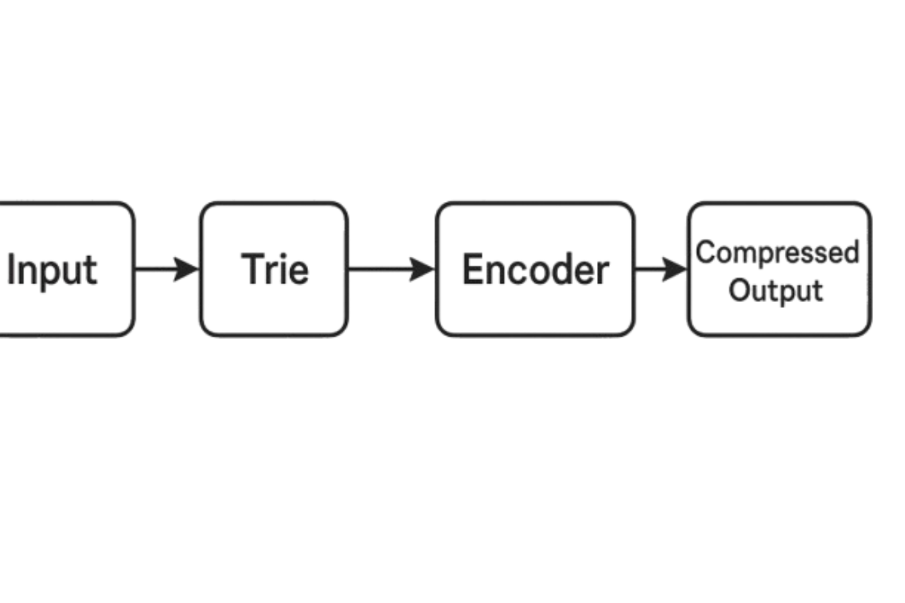
Compression Engine
Input: Read raw data (e.g., "TOBEORNOTTOBEORTOBEORNOT").
Trie Build: Dynamically grow dictionary (e.g., "TO" → 256, "TOB" → 257).
Output: Emit codes (e.g., 84, 79, 66, 69 → 256, 79, 258).

Slide 6
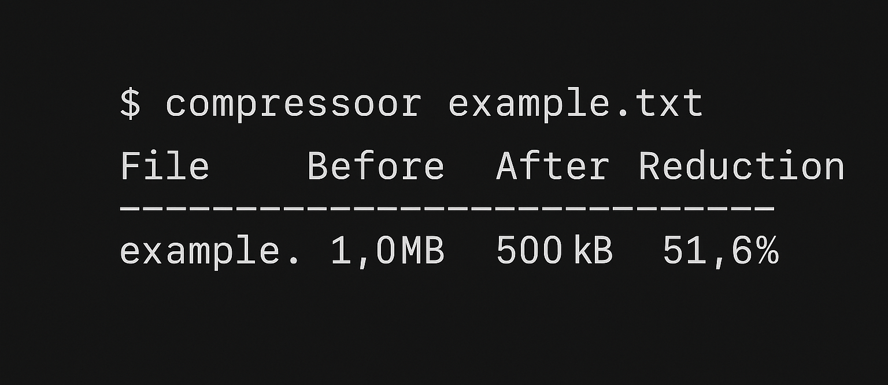
Key Innovations
Adaptive Code Width: Starts at 9 bits, grows to 16 bits as dictionary expands.
Memory Safety: Smart pointers (unique_ptr) prevent leaks.
Threading: Optional parallel compression for large files.

Slide 7
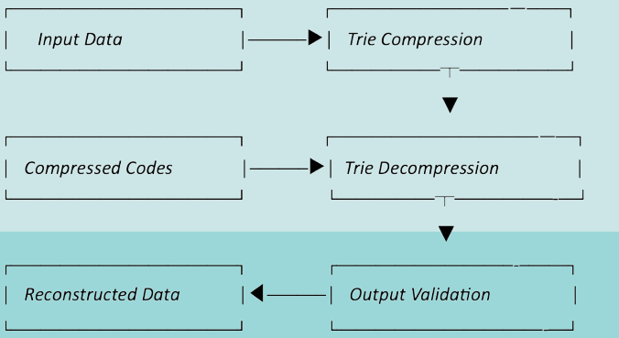
End-to-End Pipeline
Input Data: Original uncompressed information
Compressed Codes: Encoded representations of data patterns
Trie Compression: Prefix-tree based encoding process
Trie Decompression: Dictionary rebuilding from compressed trie paths
Reconstructed Data: Decompressed output regenerated from codes
Output Validation: Verification of data integrity post-compression

Slide 8
Who Does What?
Member | Role | Deliverables
Sumit | Trie Architect | Trie design, compression core
Aviral | System Engineer | Decompression, I/O, memory optimization
Anubhav | QA Lead | Test cases, benchmarks, user docs

